Slide 1
Big Resort Mountain

Slide 2
Problem Identification
Big Resort Mountain needs to find out how to maximize its profits and cut costs through finding the key resort facilities and utilize more data-driven pricing strategies with proper facility modifications.

Slide 3
Recommendation
The model recommends adding an additional run should that increases the vertical drop by 150 feet, along with installing a corresponding chair lift
It also predicts that the optimal ticket price should increase to $95.87 from $81

Slide 4
Modeling - Models
Linear Regression
Simple Forest
MAE: 9.54
MAE: 11.79

Slide 5
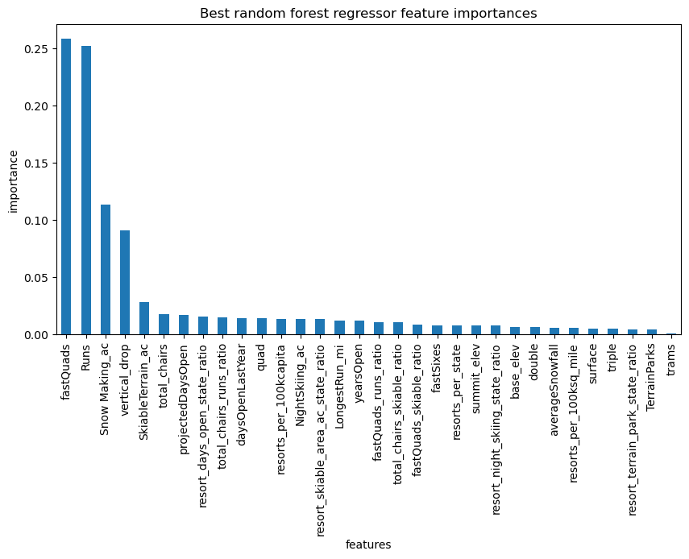
Modeling - Features

Slide 6
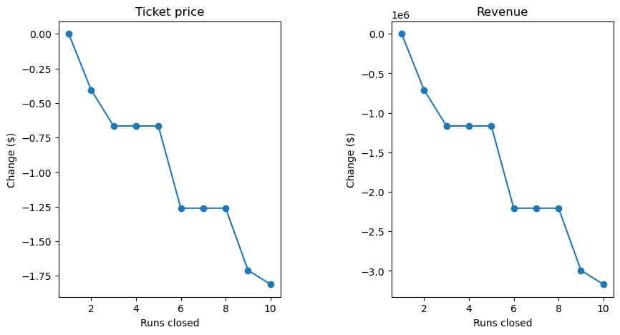
Modeling - Closing Runs

Slide 7
Modeling - Recommendation
The scenario recommended by the model predicts an increase in support for the ticket price of $1.99
Over the season, this could be expected to amount to a $3,474,638 increase in revenue
The operation costs of implementing an additional chair would amount to $1,540,000

Slide 8
Conclusion
This model heavily relies on the assumption that other resorts have implemented proper pricing strategies. It would also be valuable to further investigate how the number of visitors might change in response to a price increase. Big Mountain is already priced relatively high, but the modeled price is even higher due to its exceptional performance on most key features which would would likely improve further if the recommended changes were implemented.

